Slide 1
Self-correcting quantum memories in 3 dimensions or (slightly) less
Courtney Brell
Leibniz Universität Hannover

Slide 2
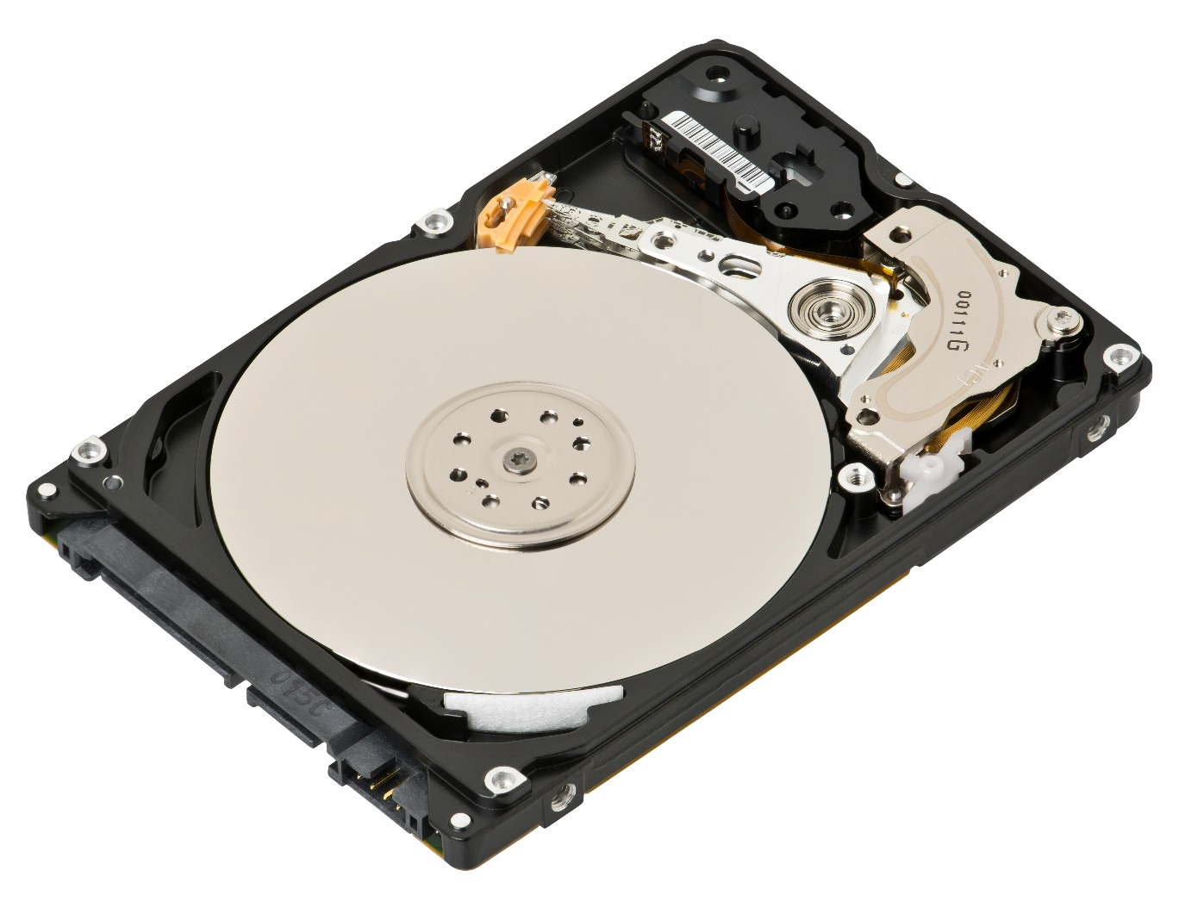
Self-correction

Slide 3
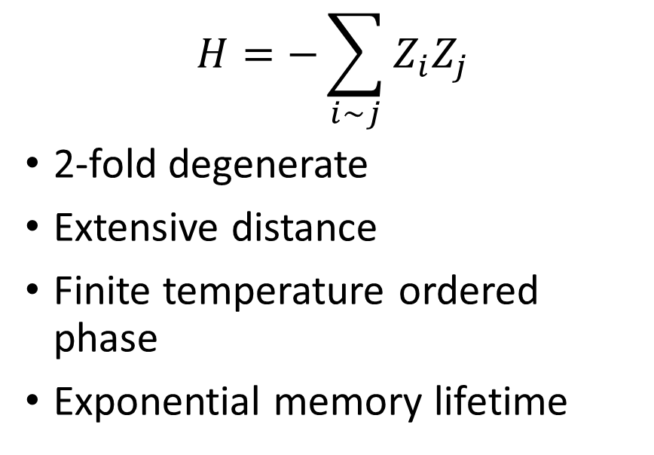
Self-correcting classical memories
2D Ising model
$$H=−\sum_{i∼j}{Z_{i}Z_{j}}$$
2-fold degenerate
Extensive distance
Finite temperature ordered phase
Exponential memory lifetime

Slide 4
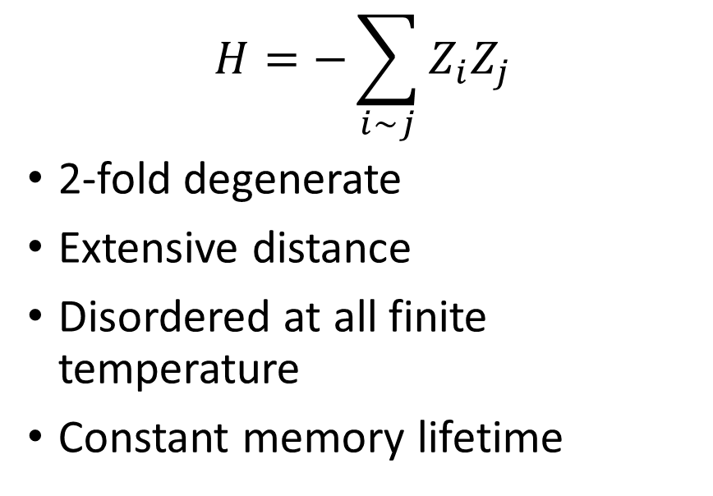
Non-self-correcting classical memories
1D Ising model
$$H=−\sum_{i∼j}{Z_{i}Z_{j}}$$
2-fold degenerate
Extensive distance
Disordered at all finite temperature
Constant memory lifetime
}
Zero temperature
{
Finite temperature

Slide 5
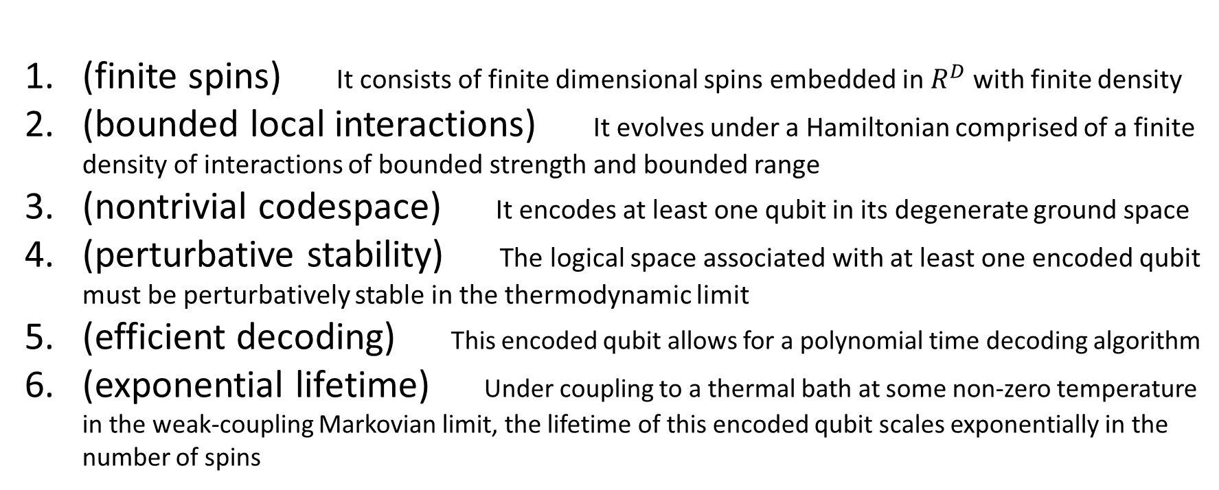
Caltech Rules
(finite spins) It consists of finite dimensional spins embedded in $R^{D}$ with finite density
(bounded local interactions) It evolves under a Hamiltonian comprised of a finite density of interactions of bounded strength and bounded range
(nontrivial codespace) It encodes at least one qubit in its degenerate ground space
(perturbative stability) The logical space associated with at least one encoded qubit must be perturbatively stable in the thermodynamic limit
(efficient decoding) This encoded qubit allows for a polynomial time decoding algorithm
(exponential lifetime) Under coupling to a thermal bath at some non-zero temperature in the weak-coupling Markovian limit, the lifetime of this encoded qubit scales exponentially in the number of spins

Slide 6
Outline
Propose a candidate code as a 3D Caltech SCQM
Leave all proofs as excercises for the reader

Slide 7
Previous strategies
(Hamma et al. 0812.4622)
2D: Toric boson model, entropic barriers
3D: Haah code, welded codes, subsystem codes, bosonic bat model
+ others
No-go results:
2D: Stabilizer models, LCPC models
3D: Translation- and scale-invariant stabilizer models
+ others
(Brown et al. 1307.6222)
(Haah 1101.1962)
(Michnicki 1208.3496)
(Bacon quant-ph/0506023)
(Pedrocchi et. al. 1309.0621)
(Bravyi, Terhal 0810.1983)
(Kay, Colbeck 0810.3557)
(Landon-Cardinal, Poulin 1209.5750)
(Yoshida 1103.1885)

Slide 8
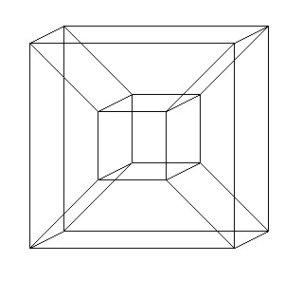
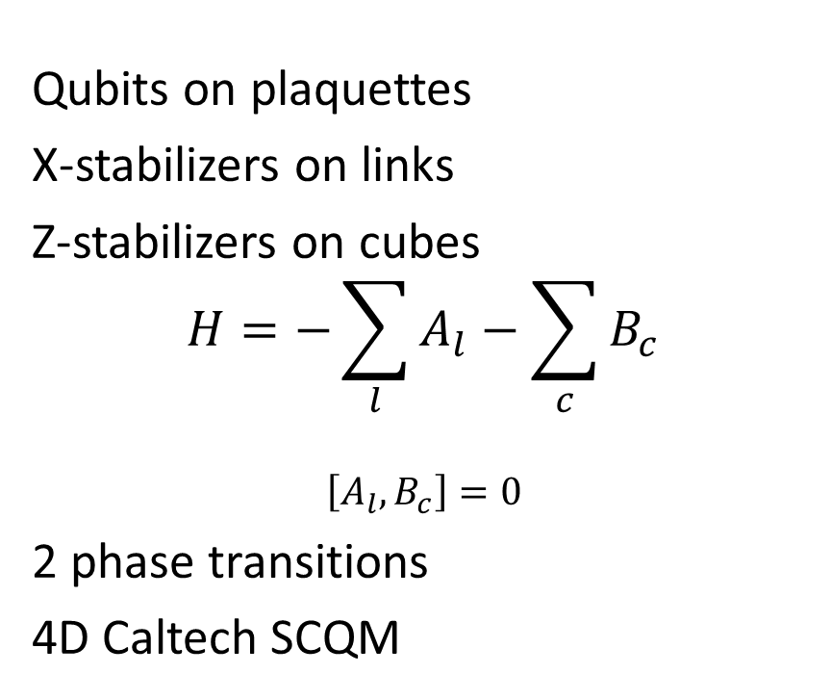
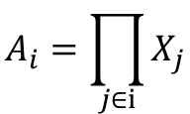
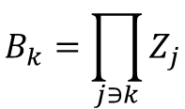
Self-correcting quantum memories
4D toric code
(Dennis et al. quant-ph/0110143)
Qubits on plaquettes
X-stabilizers on links
Z-stabilizers on cubes
$$H=−\sum_{l}{A_{l}}−\sum_{c}{B_{c}}$$
$$\left[A_{l},B_{c}\right]=0$$
2 phase transitions
4D Caltech SCQM
$$A_{i}=\prod_{j∈i}{X_{j}}$$
$$B_{k}=\prod_{j∋k}{Z_{j}}$$
(Alicki et al. 0811.0033)

Slide 9
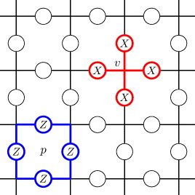
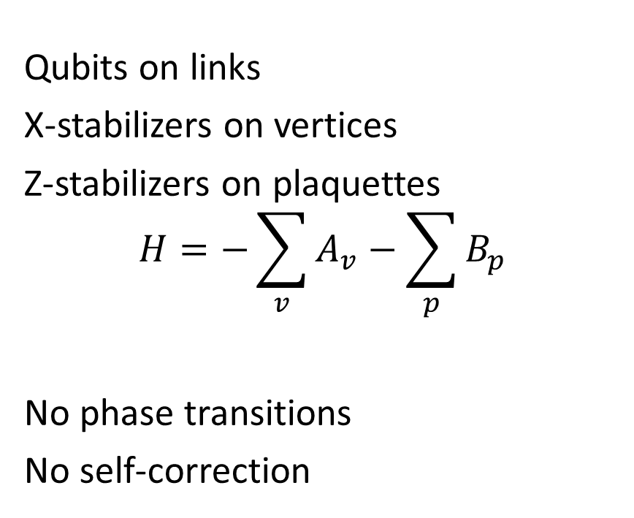
Non-self-correcting quantum memories
2D toric code
(Kitaev quant-ph/9707021)
Qubits on links
X-stabilizers on vertices
Z-stabilizers on plaquettes
$$H=−\sum_{v}{A_{v}}−\sum_{p}{B_{p}}$$
No phase transitions
No self-correction
(Alicki et al. 0810.4584)

Slide 10
Quantum is the square of classical

Slide 11
Quantum is the square of classical
4D toric code | 2D Ising model

Slide 12
Quantum is the square of classical
4D toric code | 2D Ising model
2D toric code | 1D Ising model

Slide 13
Quantum is the square of classical
4D toric code | 2D Ising model
2D toric code | 1D Ising model
3D quantum memory

Slide 14
Quantum is the square of classical
4D toric code | 2D Ising model
2D toric code | 1D Ising model
3D quantum memory | 1.5D classical memory???

Slide 15
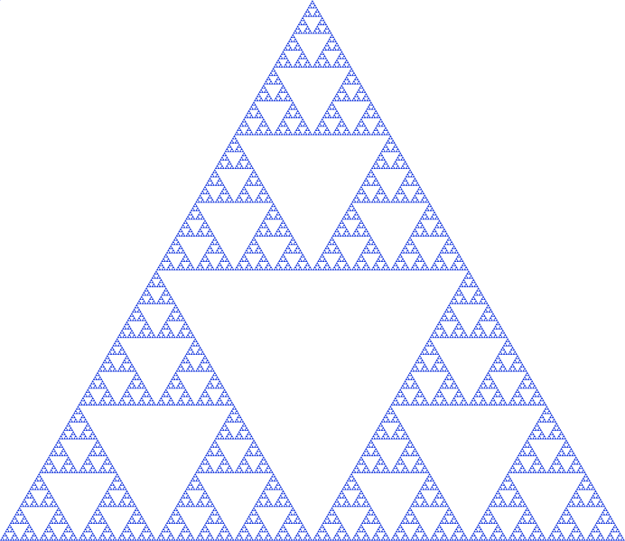
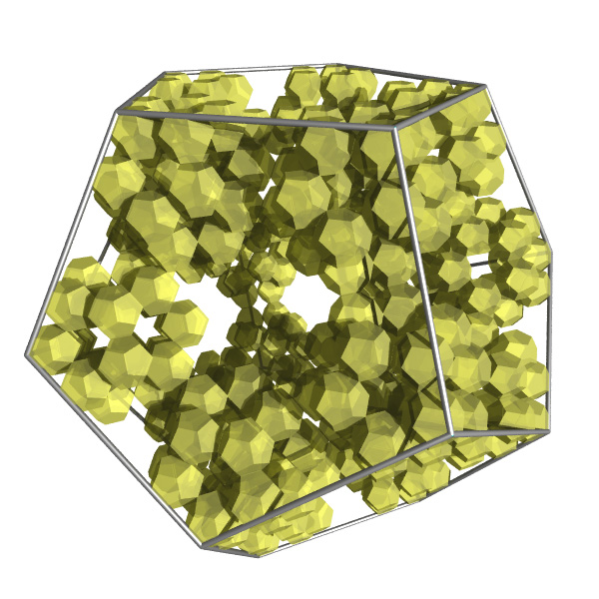
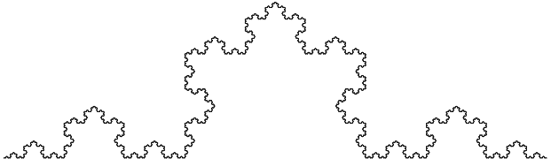
Fractal geometry
1.5849
2.3296
1.2619
Hausdorff dimension

Slide 16
Sierpinski carpet

Slide 17



Sierpinski carpet
$l=$0
$$b=3$$
$$c=1$$

Slide 18

Sierpinski carpet
$$l=1$$
$$b=3$$
$$c=1$$

Slide 19

Sierpinski carpet
$l=$2

Slide 20

Sierpinski carpet
$l=$3

Slide 21

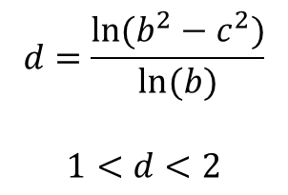
Sierpinski carpet
Sierpinski carpet graph
Thermally stable Ising model
$l=$4
$$d=\frac{ln⁡(b^{2}−c^{2})}{ln⁡(b)}$$
$$1<d<2$$
(Vezzani, cond-mat/0212497)
(Shinoda, J. Appl. Prob., 39, 1, 2002)

Slide 22
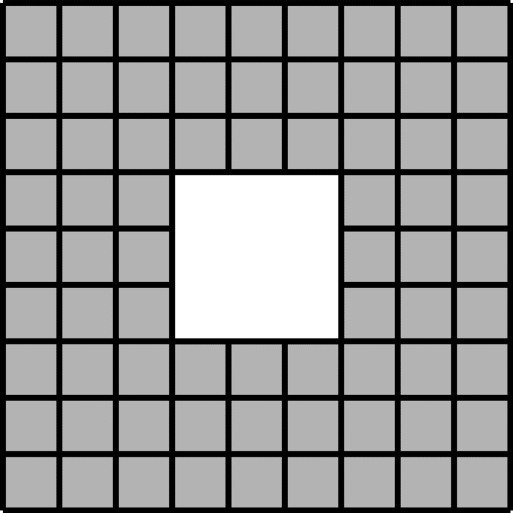
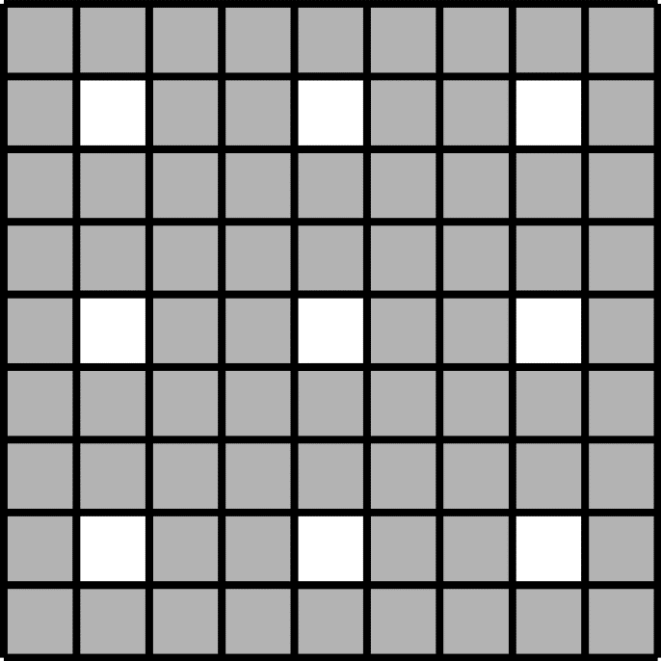
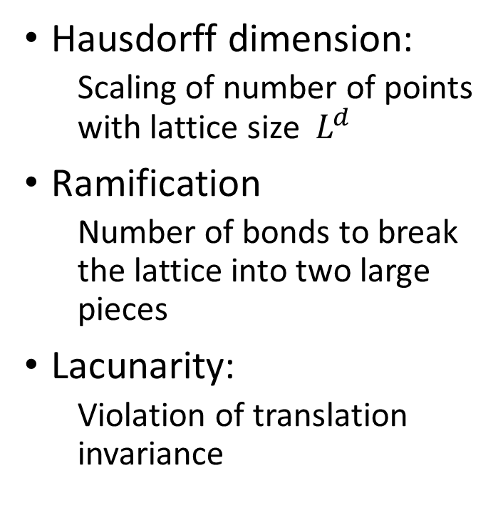
Sierpinski carpets
Hausdorff dimension:
Scaling of number of points with lattice size ${ L}^{d}$
Ramification
Number of bonds to break the lattice into two large pieces
Lacunarity:
Violation of translation invariance
High lacunarity
Low lacunarity

Slide 23
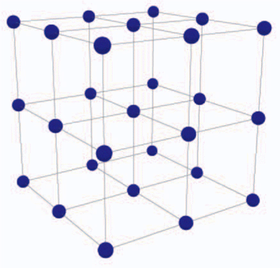
Homological CSS codes
Codes in language of algebraic topology
Qubits on i-dimensional objects
X stabilizers on (i-1)-dimensional objects
Z stabilizers on (i+1)-dimensional objects

Slide 24

Fractal Product Codes
(Freedman, Hastings 1301.1363)
Homological product
(Bravyi, Hastings 1311.0885)
$$×$$
i=1
i=1

Slide 25

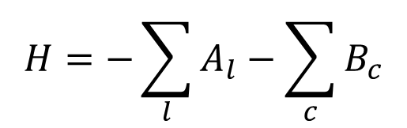
4D complex – subgraph of hypercubic lattice
Qubits on 2D objects
X-type stabilizers on 1D objects
Z-type stabilizers on 3D objects
4D toric code with punctures
$$×$$
$$H=−\sum_{l}{A_{l}}−\sum_{c}{B_{c}}$$

Slide 26
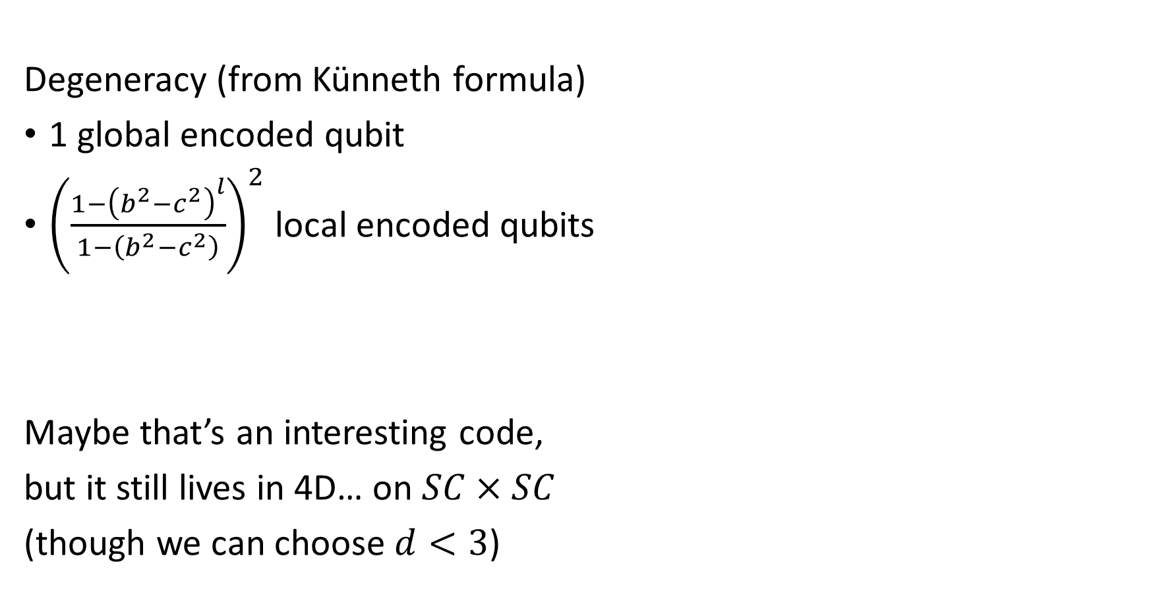
Degeneracy (from Künneth formula)
1 global encoded qubit
${\left(\frac{1−{\left(b^{2}−c^{2}\right)}^{l}}{1−\left(b^{2}−c^{2}\right)}\right)}^{2}$ local encoded qubits
Maybe that’s an interesting code,
but it still lives in 4D… on $SC×SC$
(though we can choose $d<3$)
$$×$$

Slide 27

Projection to 3D
Random projections preserve (small enough) Hausdorff dimension
(global structure)
Doesn’t increase distance between qubits
Local interactions $→$ local interactions
In general, this does increase density
Can we bound this?
In the limit of low lacunarity, density approaches translation invariant
Constant density + $d<3$ $⇒$ bounded density after projection

Slide 28
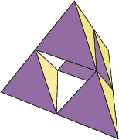
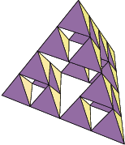
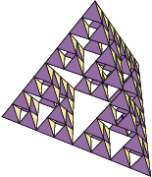
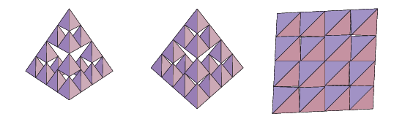
http://mathworld.wolfram.com/Tetrix.html

Slide 29
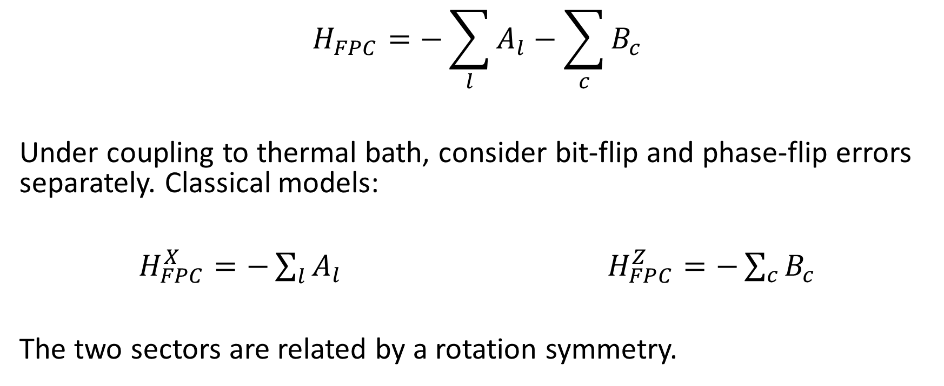
Thermodynamic properties of FPCs
$$H_{FPC}=−\sum_{l}{A_{l}}−\sum_{c}{B_{c}}$$
Under coupling to thermal bath, consider bit-flip and phase-flip errors separately. Classical models:
$H_{FPC}^{X}=−\sum_{l}{A_{l}}$ $H_{FPC}^{Z}=−\sum_{c}{B_{c}}$
The two sectors are related by a rotation symmetry.

Slide 30
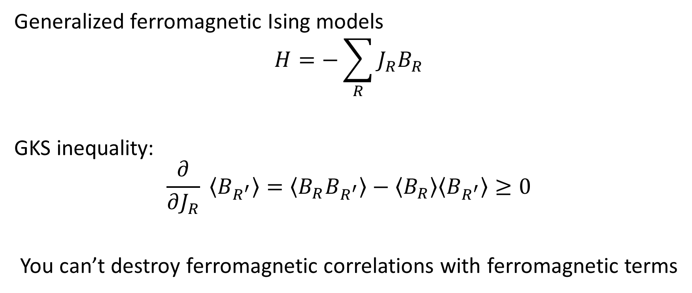
Correlation inequalities
Generalized ferromagnetic Ising models
$$H=−\sum_{R}{J_{R}B_{R}}$$
GKS inequality:
$$\frac{∂}{∂J_{R}} \left\langle B_{R^{′}}\right\rangle =\left\langle B_{R}B_{R^{′}}\right\rangle −\left\langle B_{R}\right\rangle \left\langle B_{R^{′}}\right\rangle ≥0$$
You can’t destroy ferromagnetic correlations with ferromagnetic terms
(Griffiths, J. Math. Phys. 8, 478, 1967)
(Kelly, Sherman, J. Math. Phys. 9, 466, 1968)

Slide 31
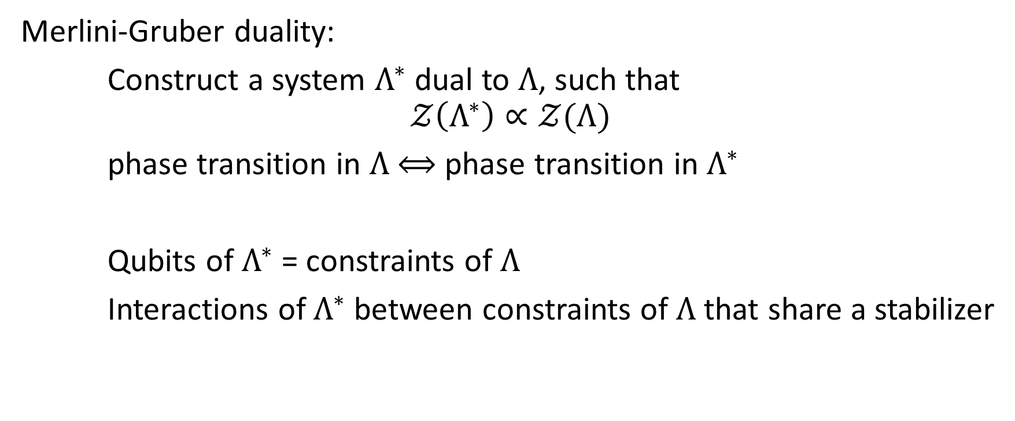
Duality transformations
Merlini-Gruber duality:
Construct a system $Λ^{∗}$ dual to $Λ$, such that
$$𝒵\left(Λ^{∗}\right)∝𝒵(Λ)$$
phase transition in $Λ$ $⟺$ phase transition in $Λ^{∗}$
Qubits of $Λ^{∗}$ = constraints of $Λ$
Interactions of $Λ^{∗}$ between constraints of $Λ$ that share a stabilizer
(Merlini, Gruber, J. Math. Phys. 13, 1814, 1972)

Slide 32
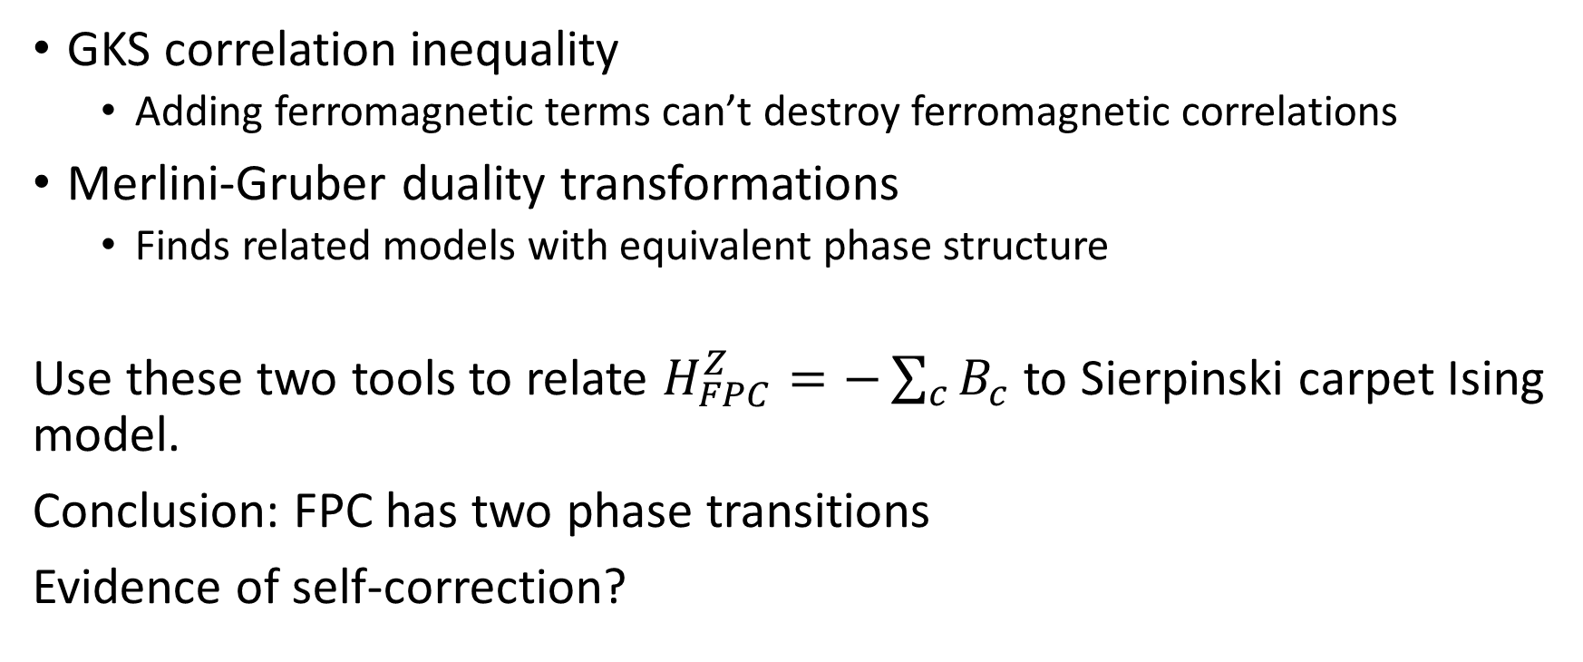
Main ideas of thermodynamic analysis
GKS correlation inequality
Adding ferromagnetic terms can’t destroy ferromagnetic correlations
Merlini-Gruber duality transformations
Finds related models with equivalent phase structure
Use these two tools to relate $H_{FPC}^{Z}=−\sum_{c}{B_{c}}$ to Sierpinski carpet Ising model.
Conclusion: FPC has two phase transitions
Evidence of self-correction?

Slide 33
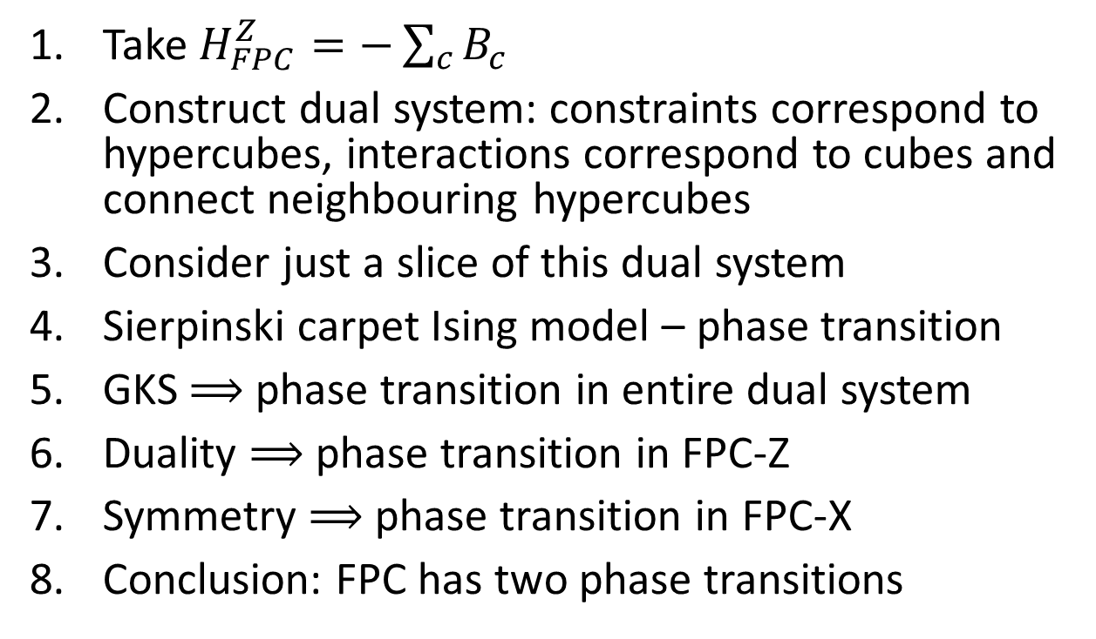
Phase transitions in FPCs
Take $H_{FPC}^{Z}=−\sum_{c}{B_{c}}$
Construct dual system: constraints correspond to hypercubes, interactions correspond to cubes and connect neighbouring hypercubes
Consider just a slice of this dual system
Sierpinski carpet Ising model – phase transition
GKS $⟹$ phase transition in entire dual system
Duality $⟹$ phase transition in FPC-Z
Symmetry $⟹$ phase transition in FPC-X
Conclusion: FPC has two phase transitions
$$×$$

Slide 34
Caltech checklist
Open Questions
finite spins
bounded local interactions
nontrivial codespace
perturbative stability
efficient decoding
exponential lifetime
Caltech rule proofs
general perturbative stability
general lifetime proofs
Alternative fractals
Numerical study
?
☑
☑
?
?
?
Thanks.

